Slide 1
MVC Paradigm in Vanilla JS
Implementation by building a basic “ToDo” app
https://www.taniarascia.com/javascript-mvc-todo-app/

Slide 2
What is MVC?
MVC is one possible programming pattern for organizing your code, focusing on separation of concerns.
The idea is to make the solution intelligible and inviting.
Any fellow programmer looking to make specific changes can find the right spot with ease.

Slide 3
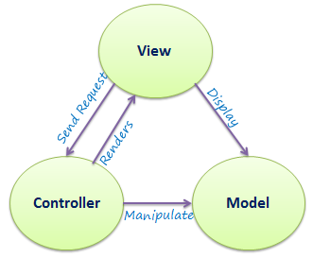
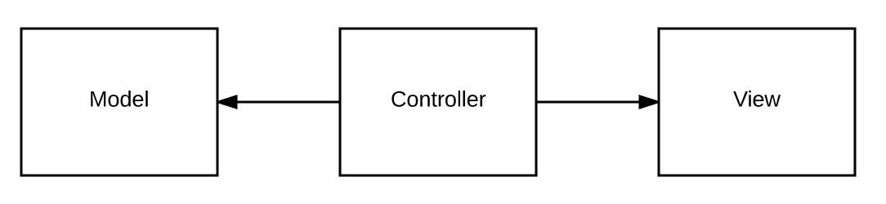
MVC Diagrams

Slide 4
Breakdown:
The model is the data, and usually functions that manipulate data
The view is how the data is displayed: HTML in the DOM and CSS.
The controller connects the model and the view.
Neither the controller nor the model should know anything about the DOM, HTML elements, CSS, or any of that. Anything relating to it should be in the view.

Slide 5
The View
Cares about the DOM. The DOM is the browser API you use to make HTML manipulations. (Document Object Model)
In MVC, no other part cares about changing the DOM except for the view. The view can attach user events but leaves event handling concerns to the controller.
The view’s prime directive is to change the state of what the user sees on the screen.
The view is listening to the controller for actions to manipulate the DOM.

Slide 6
The Controller
Takes user input, such as clicking or typing, and handles callback functions for user interactions.
The controller is the link between the model (the data ) and the view (what the user sees).
Client-side specific logic can go in the controller.
The controller is the entry point for events and the only mediator between the view and data.
When you submit a new todo, or click the delete button, or click on the checkbox of a todo, an event will be fired. The view must listen for those events because they're user input of the view, but it will dispatch the responsibility of what will happen in response to the event to the controller.

Slide 7
The Model
Cares about data. In client-side JavaScript, this usually means Ajax and its helper functions
the ‘todos’, and the methods that will add, edit, or delete them.
In our example these are functions that manipulate local storage in the browser (the ‘todos’, and the methods that will add, edit, or delete them.)
The model only deals with the actual data and modifying that data. It doesn't understand or have any knowledge the input - what's modifying it, or the output - what will end up displaying.

